Slide 1


BIOENG-310
KEVAN LAM
FERDINAND CHIU
RECEPTORS FOR
TEMPERATURE AND TOUCH
DAVID JULIUS AND ARDEM PATAPOUTIAN

Slide 2

PLAN
01
INTRO
02
RECEPTORS FOR TEMPERATURE
a. TRPV1 and TRPM8
b. How did they find them, how do they work?
03
RECEPTORS FOR TOUCH
a. Piezo 1 and Piezo 2
b. What are they?
04
CONCLUSION AND QUESTIONS

Slide 3
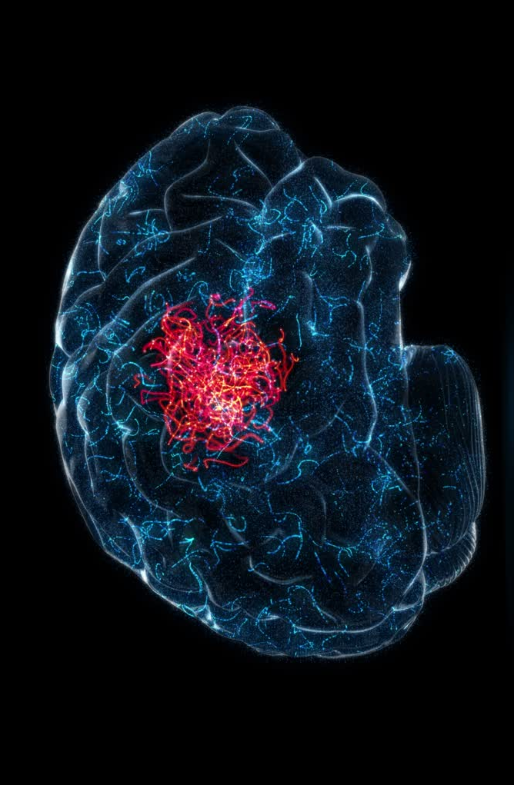

INTRO
Why does pepper feel hot, and mint feels cold?
How do we feel pressure on our skin?
Why is it important?

Slide 4

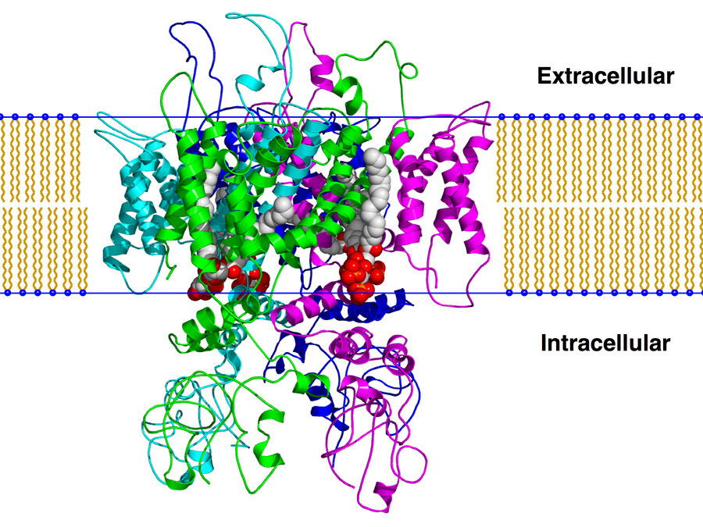
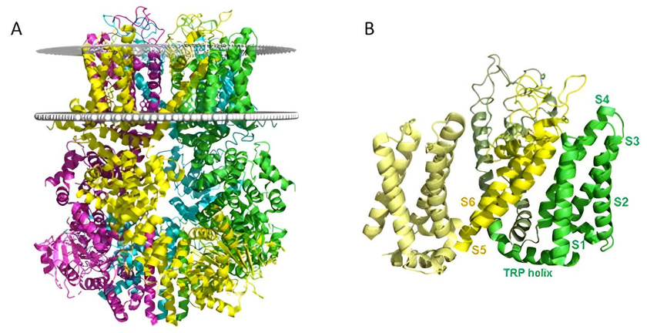
TEMPERATURE RECEPTORS
Ion channel opening at >= 43°C
TRPV1:
Sensitive to capsaicin
Opens at <= 25°C
TRPM8:
Sensitive to menthol

Slide 5
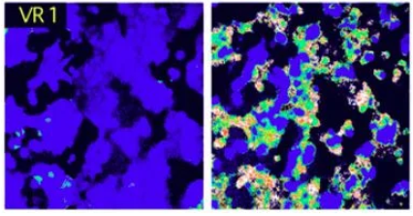
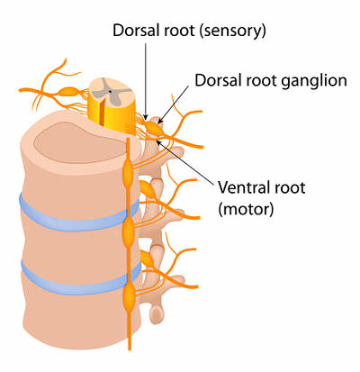
HOW DID THEY FIND THE RECEPTORS?
Conjecture: a single gene is reponsible for sensitivity to capsaicin
1
2
3
4
EXTRACT DNA FRAGMENTS
DIVIDE THE LIBRARY IN BATCHES + TRANSFECTION + DYE
OBSERVE
REPEAT UNTIL FOUND
transfect cDNA in naïve human kidney cells, dye them, and expose them to capsaicin

Slide 6
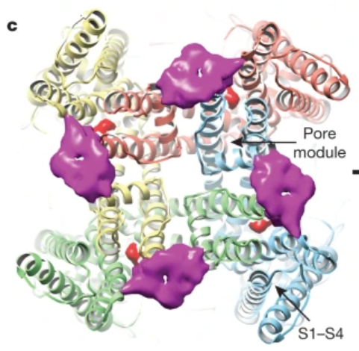
HOW DOES IT WORK?
Present in afferent neurons (nerve endings in skin and mucus areas, Dorsal Root Ganglion)
1) Heat: not well understood
2) capsaicin and RTX: binds directly on the receptor
3)a)Lesion → surplus of certain components in affected area (H⁺, ATP) → TRPV1 becomes more sensitive (burning sensation)
3)b)Lesion → NGF is spread → binds on a G-Receptor → TRPV1 transcription factor ++
Not a voltage-gated channel!

Slide 7
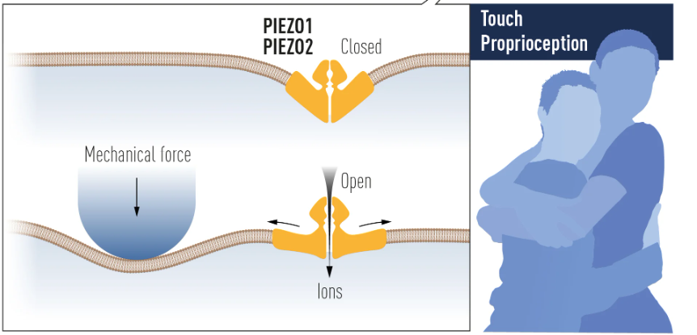

MECHANORECEPTOR FOR TOUCH
Open when the cell membrane is deformed
This allows ions (such as Ca²⁺ and Na⁺) to enter, creating an electrical signal

Slide 8
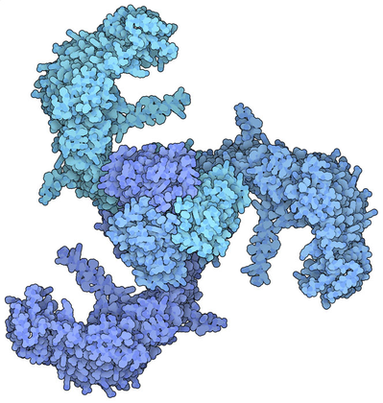
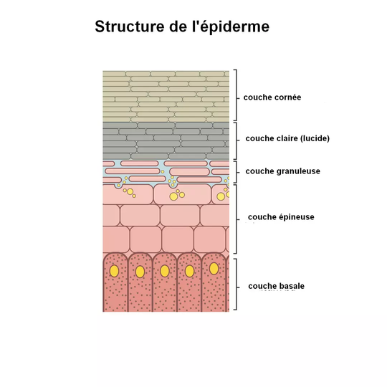
TOUCH RECEPTORS
Touch receptors let calcium in->
dilate the vessel and regulate blood pressure.
Piezo 1:
Sensitive to internal forces
Fine touch and body position
Piezo 2:
Classic touch

Slide 9




WHAT'S IT ALL ABOUT?
Proprioception
Neurological disease
Major discovery
Piezo2 is essential for body position perception
Mutations in Piezo1/Piezo2 are implicated in certain neurological diseases
Revolutionnary!

Slide 10

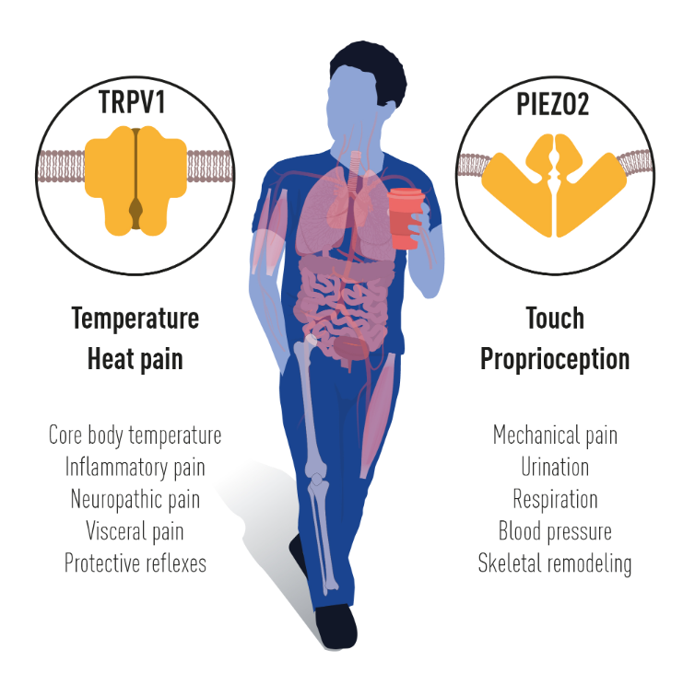



MEDICAL ApplicatiONS AND IMPACT
Targeting TRPV1 could help treat chronic pain.
And Piezo 2 in tactile pain
PAIN MANAGEMENT
Understanding Trpv1 and Piezo 2 helps develop human-machine interfaces
At the moment we still don’t understand certain mechanisms
PROSTHESES AND NEUROLOGICAL DISORDERS
CURRENT ADVANCED

Slide 11
THANKS :)
FERDINAND CHIU
KEVAN LAM

Slide 12
SOURCES
https://www.nobelprize.org/prizes/medicine/2021/advanced-information/
https://pubmed.ncbi.nlm.nih.gov/10066837/
E.Cao et. al, TRPV1 structures in distinct conformations reveal activation mechanisms. Nature, 2013
The capsaicin receptor: a heat-activated ion channel in the pain pathway. Nature, 1997
Impaired PIEZO1 function in patients with a novel autosomal recessive congenital lymphatic dysplasia
Familial Gordon syndrome associated with a PIEZO2 mutation. Am J Med Genet A
Szczot, M., J. Liljencrantz, N. Ghitani, A. Barik, R. Lam, J.H. Thompson, D. Bharucha-Goebel, D. Saade, A. Necaise, S. Donkervoort, A.R. Foley, T. Gordon, L. Case, M.C. Bushnell, C.G. Bönnemann, and A.T. Chesler, PIEZO2 mediates injury-induced tactile pain in mice and humans

